Slide 1
Nginx for .NET Developers
Moving on from IIS

Slide 2
Who are you?
Software Developer for more than 20 years
Worked mainly for ISVs
Reuters, SunGard, Misys, Huddle
Worked for a couple of MIS departments
DTI, Beazley
Microsoft MVP for C#
Interested in architecture and design
Interested in Agile methodologies and practices
No smart guys
Just the guys in this room

Slide 3

Secure document collaboration for teams, enterprises and government organizations

Slide 4


Slide 5
Agenda
Runaround
Kestrel
Nginx
Reverse Proxy
Load Balancing
Q&A

Slide 6
Runaround
A quick tour of nginx, kestrel and asp.net, running on Docker

Slide 7
10m

Slide 8
Demo
Notes:
Demo (15 mins)
Simplified version of FutureStack ToDo Backend Running Under Kestrel (5 mins)
Slides to Describe App (2)
Demo: Walkthrough of App (basic)
Uses Docker Compose to set up
Use a ToDo client to show it working
Adding NGinx to the mix (10 mins)
Demo: Nginx actins as a Reverse Proxy and a Load Balancer
Just use the nginx_load_balancer branch
This is simple, as the conf has just the basics, and not all the detail that we add on later with reverse proxy
Don't do -d on docker-compose so that you can more easily show different calls hitting different servers
See: https://www.youtube.com/watch?v=HJ9bECmuwKo
Shows Docker as Reverse Proxy
Shows Using Scale to give more instances
How and Why?
Why would we do this?
How do we do this?
That is the subject of the talk.

Slide 9
Kestrel

Slide 10
5m

Slide 11
https://docs.microsoft.com/en-us/aspnet/core/fundamentals/servers/?tabs=aspnetcore2x

Slide 12
Kestrel
libuv based; but not intended as .NET libuv server/wrapper
x-platform
Production HTTP server for ASP.NET Core

Slide 13
Kestrel Architecture
libuv is a single-threaded event loop
Kestrel supports multiple libuv loops
Kestrel only does I/O on the libuv loop
HTTP parsing, handlers etc. done a managed code worker thread.
Optimized for low number of SYS calls

Slide 14
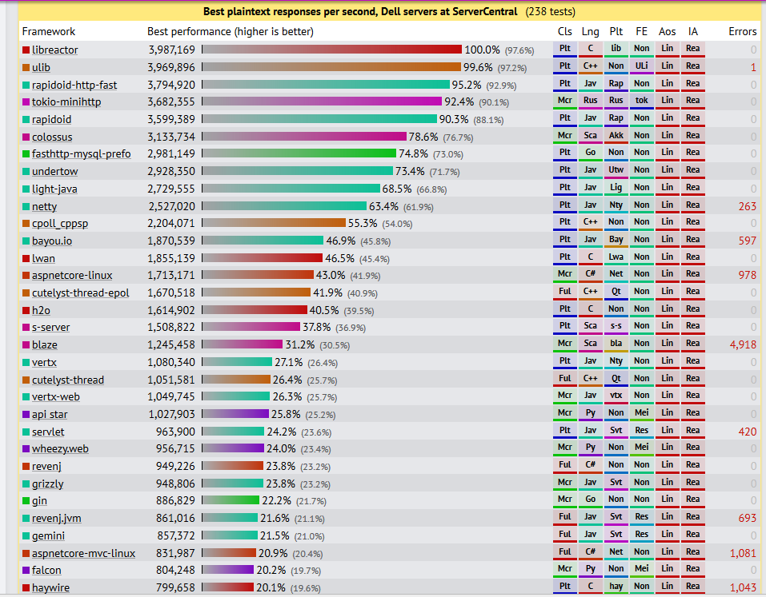
TechEmpower Round 14 2017-05-10
Notes:
Kestrel is fast, look at TechEmpowere benchmarks
Note that the ongoing work around Span<T> and Pipelines is about improving the performance of Kestrel towards the levels Java has with Netty; it’s all about improving how we read memory from a buffer

Slide 15

https://docs.microsoft.com/en-us/aspnet/core/fundamentals/servers/?tabs=aspnetcore2x
Notes:
Kestrel lacks some features that we might expect from a full web-server
It does not support SSL, Compression, Rate Limiting, URL rewriting, Static Files, and other key features we might expect in a web server coming from IIS
It does not support caching (though you can use middleware to cache in ASP.NET Core).
Kestrel is intended to be deployed behind a proxy that provides these services, such as IIS, Apache or Nginx

Slide 16
Nginx

Slide 17
15m

Slide 18
nginx
An x-platform webserver – serves content in response to HTTP(S) (or SMTP)
Can serve static content i.e. from disk directly
Can use http or fastCGI to call web application that serves dynamic content
nginx is not an application container, it does not host your app!
It does I/O to fulfil an HTTP request
This makes it possible to optimize its architecture around asychonous I/O operations

Slide 19
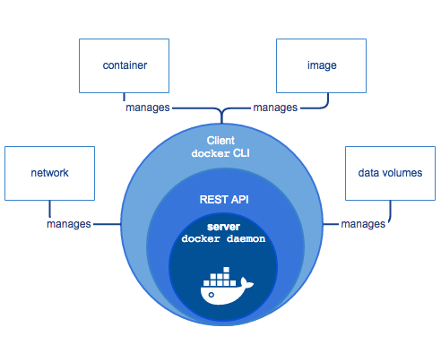
Then
Now
https://docs.microsoft.com/en-us/iis/get-started/introduction-to-iis/introduction-to-iis-architecture
https://docs.docker.com/engine/docker-overview/#docker-engine
Notes:
On the left we have IIS
When a client browser initiates an HTTP request for a resource on the Web server, HTTP.sys intercepts the request.
HTTP.sys contacts WAS to obtain information from the configuration store.
WAS requests configuration information from the configuration store, applicationHost.config.
The WWW Service receives configuration information, such as application pool and site configuration.
The WWW Service uses the configuration information to configure HTTP.sys.
WAS starts a worker process for the application pool to which the request was made.
The worker process processes the request and returns a response to HTTP.sys. The client receives a response.
This is an application container; It’s how we used to deploy
On the right we have Docker
The Dockser Host runs a docker daemon
The daemon communicates outside the host via a REST API
The Docker CLI communicates with the daemon via the API
The daemon downloads an image from the registry
The daemon creates a sandboxed process called a container, that shares kernel resources, but protects apps from each other in user space
The daemon can create a network between the containers and storage voumes for them to share
It is also an ‘application container’
There is no point in putting an application container like IIS inside a container like a Docker

Slide 20
Architecture

Slide 21
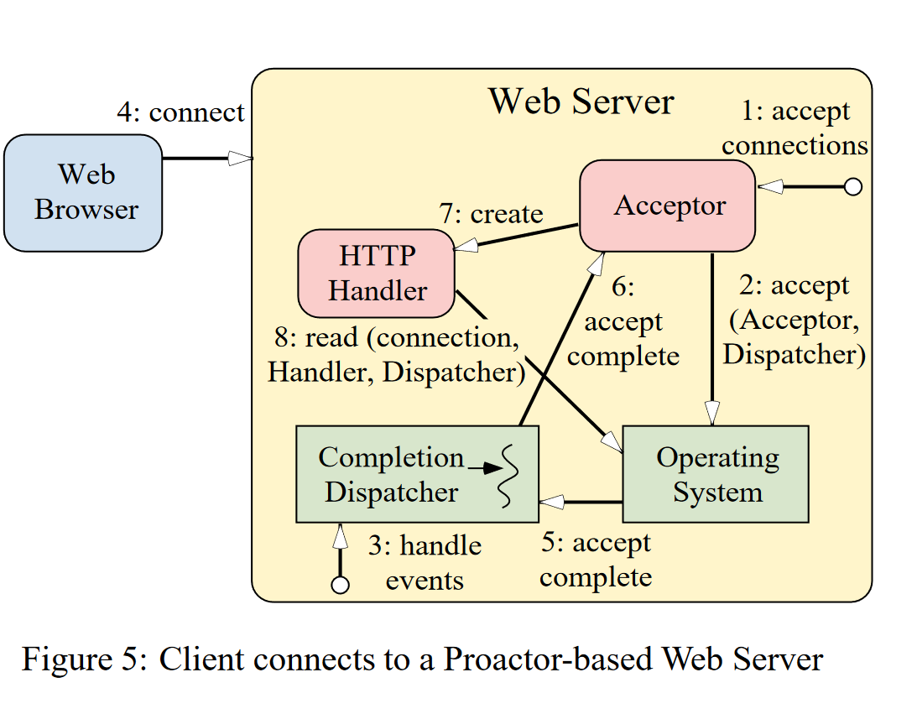
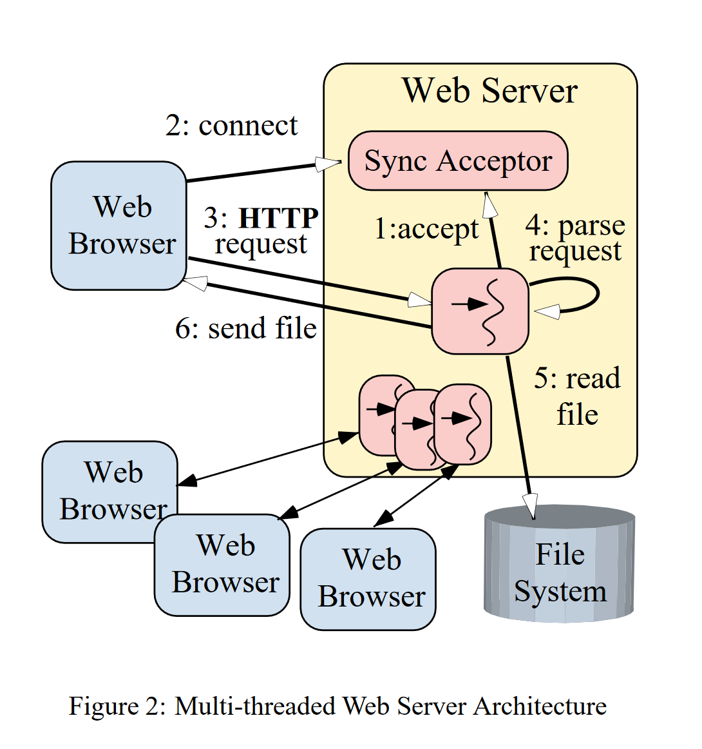
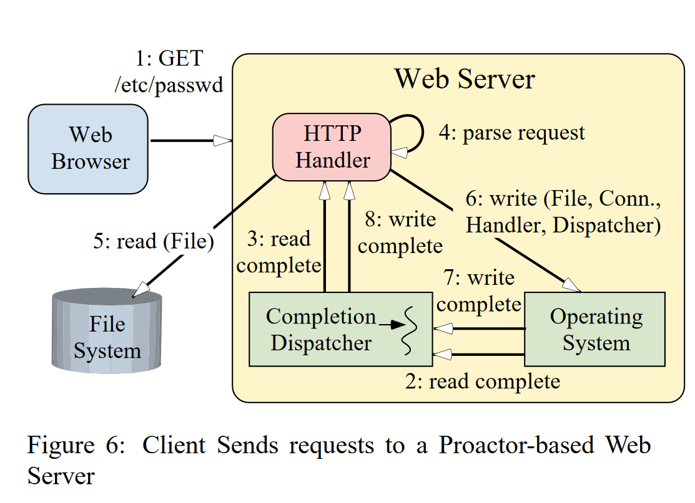
http://www.cs.wustl.edu/~schmidt/PDF/proactor.pdf
Notes:
Perhaps the most intuitive way to implement a concurrent Webserver is to use synchronous multi-threading. .In this model, multiple server threads process HTTP
GET requests from multiple clients simultaneously. Each thread performs connection establishment, HTTP request reading, request parsing, and file transfer operations synchronously. As a re-
sult, each operation blocks until it completes. The primary advantage of synchronous threading is the simplification of application code. In particular, operations performed by a Web server to service client A’s request are
mostly independent of the operations required to service client B’s request. Thus, it is easy to service different requests in separate threads because the amount of state shared
between the threads is low, which minimizes the need for synchronization. Moreover, executing application logic in separate threads allows developers to utilize intuitive sequen-
tial commands and blocking operations.
1. Each thread synchronously blocks in the accept
socket call waiting for a client connection request;
2. A client connects to the server, and the connection is accepted;
3. The new client’s HTTP request is synchronously read from the network connection;
4. The request is parsed;
5. The requested file is synchronously read;
6. The file is synchronously sent to the client
A thread per connection model will fail to scale on a webserver.
This is because once the number of threads exceeds the number of available CPUs we will experience context switching, which has has an overhead in time and memory, as the scheduler allocates time to each thread.
As the number of connections grows a higher-and-higher percentage of the CPU time is spent context switching until the CPU spends more time context switching than processing requests.
If the request has blocking I/O we may be able to have more threads, because some part of the request will actually be waiting on I/O so we can switch away from them. Thread Pool based solutions to web servers tend to rely on the fact that a request will spend much of its time in blocking I/O and inject new threads when existing threads are stalled on I/O to allow more threads to run.
Even so, a thread pool based solution will eventually not be able to process even simple requests before they time out.
An alternative is to use an asychronous event loop:
A worker thread waits to be signaled that there is a connection.
It then processes the request, until the request hits a wait-able operation (i.e. one that is asynchonous) and then services the next connection, and so on
As long as the request processing can be as asynchronous as possible, then the worker can efficiently use its time slice to service multiple requests.
Nginx uses this evented approach (its an implementation of the proactor pattern)
A master process acts as the supervisor, and spawns a number of worker threads.
The supervisor also reads the configuration file and validates it
A worker process listens for connections, and then processes the request, until that request waits, upon which point is processes the next connection, if there is one, until it too waits. As awaited apps complete they are signaled for the thread to schedule in turn

Slide 22
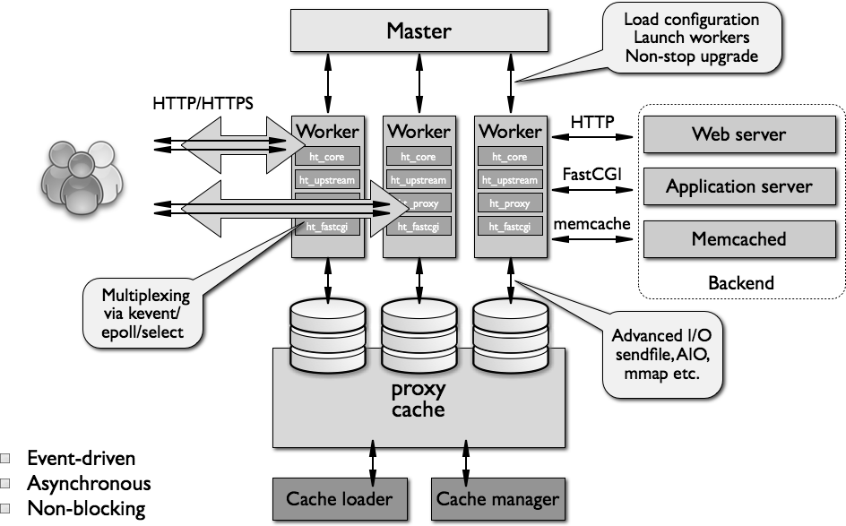
http://www.aosabook.org/en/nginx.html
Notes:
In addition to the supervisor and worker(s), niginx runs a cache loader and cache processor thread
Nginx is itself a web server and can serve requests from the file system, both static content and cached content.
But Nginx can also act as a reverse proxy to another web server, such as Apache or Kestrel.
For servers that support FastCGI (or UWSGI etc.) Nginx can optimize passthrough
In addition, Nginx can use memcached or Redis as a cache instead of the file system via a passthrough mechanism.

Slide 23
Configuration

Slide 24
To use nginx we need to write a configuration file that describes the content and sites we want to host
The configuration file is made up of directives
# I am a comment
some_setting value;
Modules bring in new directives when linked into nginx

Slide 25
A directive may be contained in a block, which groups directives and scopes them
http {
server {
listen 80;
server_name example.com;
access_log /var/log/nginx/example.com.log;
location ^~ /admin/ {
index index.php;
}
}
}

Slide 26
There three base modules that are always available
Core: Process and Thread Management, Security
Events: How does the event loop run
Configuration: Allows you to include a file with directives
include /file/path.conf; include sites/*.conf;

Slide 27
To use it as a web server there are other key modules
HTTP Core: Allows you to configure virtual hosts
Rewrite: URL rewriting
HTTPUpstream: Load Balancing
HttpProxyModule: Load Balancing

Slide 28
If you don’t like the options in the docker image or apt-get repo.
You need to build from source
Using configure to generate a make script based on module selections
Then build nginx yourself.
Outside the scope of this session.

Slide 29
nginx is extensible through a range of 3rd paty modules
OpenResty turns nginx into an application server
It is a bundle of modules
It ships with the LuaJit 2.1 compiler
Kong is an API Gateway built on top of OpenResty
It is a bundle of modules
It uses Cassandra as a data store

Slide 30
At the root of the file, the global section is used for parameters that affect the entire server such as the number of worker processes, logging and how the event loop is managed
# the load is CPU-bound and we have 4 cores
worker_processes 4;
# explicitly specifying the path to the mandatory error log; turn on debug error_log error_log /var/log/nginx/error.log debug;
# use epoll on Linux
events {
use epoll;
worker_connections 2048; }
Notes:
Directives are divided into simple directives and block directives. A simple directive consists of the name and parameters separated by spaces and ends with a semicolon (;). A block directive has the same structure as a simple directive, but instead of the semicolon it ends with a set of additional instructions surrounded by braces ({ and }). If a block directive can have other directives inside braces, it is called a context (examples: events, http, server, and location).
Directives placed in the configuration file outside of any contexts are considered to be in the main context. The events and http directives reside in the main context, server in http, and location in server.

Slide 31
The http block has directives that affect how we handle http connections.
Within http we define a number of virtual servers with the server block
A virtual server is a combination of the listen and server_name directives
Listen: IP address/port or unix socket to listen on
server_name: identifies the host that the virtual server represents
A location directive may be used within a virtual server
It informs nginx how to process a URI
It may be external or internal
Notes:
Any context beginning with the keyword server is considered a virtual server section. It describes a logical separation of a set of resources that will be delivered under a different server_name directive. These virtual servers respond to the HTTP requests, and are contained within the http section.
A virtual server is defined by a combination of the listen and server_name directives. The listen directive defines an IP address/port combination or path to a UNIX-domain socket:
listen address[:port]; listen port; listen unix:path;
The listen directive uniquely identifies a socket binding under NGINX. There are a number of optional parameters that listen can take:
The server_name directive is fairly straightforward and it can be used to solve a number of configuration problems. Its default value is "", which means that a server section without a server_name directive will match a request that has no Host header field set. This can be used, for example, to drop requests that lack this header:
server { listen 80; return 444; }

Slide 32
http {
sendfile on;
tcp_nopush on;
tcp_nodelay on;
keepalive_timeout 65;
server {
listen 80;
server_name www.example.com;
location / {
try_files $uri $uri/ @kestrel;
location @kestrel {
proxy_pass http://app:5000
}
}
}

Slide 33
Demo
Notes:
Show the nginx_load_balancer config as its simple; promise a more production ready version when we talk about reverse proxies

Slide 34
Reverse Proxy

Slide 35
20m

Slide 36
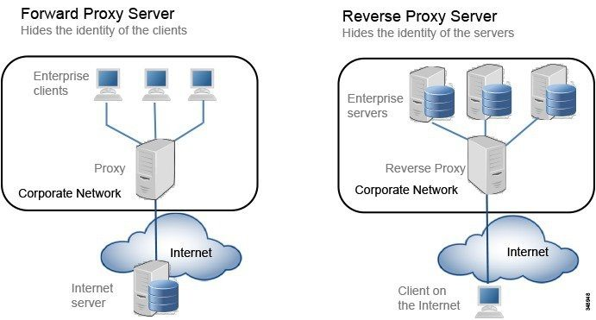
https://www.cisco.com/c/en/us/td/docs/solutions/CVD/Collaboration/enterprise/collbcvd/edge.html

Slide 37
HTTP Caching
HTTP caches downstream of the origin server
We trade performance for the risk of becoming stale
We may also trade availability for consistency
A browser cache is low-latency, but not shared
A proxy cache has higher-latency, but is shared

Slide 38
Max Age
1.Browser Request
GET usr/113/avatar.png HTTP/1.1
Cache-Control max-age=30
Within Expiration
Origin Server
Not Contacted
2. Load from proxy or browser cache

Slide 39
Expires
1.Browser Request
GET usr/113/avatar.png HTTP/1.1
Expires: Fri, 19 Jan 2018 09:00:00 GMT
Within Expiration
Origin Server
Not Contacted
2. Load from proxy or browser cache

Slide 40
Last Modified (Proxy not forcing revalidation)
1.Browser Request
GET usr/113/avatar.png HTTP/1.1
If-Modified-Since: Fri, 15 Jan 2018 09:00:00 GMT
Last Modified matches If_Modified-SInce
Origin Server
Not Contacted
2. Load from proxy or browser cache

Slide 41
Last Modified (Proxy Forcing Revalidation)
1.Browser Request
GET usr/113/avatar.png HTTP/1.1
If-Modified-Since: Fri, 15 Jan 2018 09:00:00 GMT
Cache-Control: no-cache
Proxy Server forwards request to Origin Server to revalidate
Origin Server
Compares If-Modified-Since to resource Last Modified date
2. Load from proxy or browser cache
3
304 Not Modified

Slide 42
Privacy
We can also use a Cache-control header to control privacy – who gets to see the stored content:
Cache-Control: public any proxies can store it
Cache-Control: private only the browser can store it
Cache-Control: no-store nobody keeps a copy, must go to origin
Cache-Control: no-cache NOT PRIVACY origin server must validate freshness [see also must-revalidate, max-age=0], but nginx does not store

Slide 43
proxy_cache_path /path/to/cache levels=1:2 keys_zone=my_cache:10m max_size=10g
inactive=60m use_temp_path=off;
server {
# ...
location / {
proxy_cache my_cache;
proxy_cache_revalidate on;
proxy_cache_min_uses 3;
proxy_cache_use_stale error timeout updating http_500 http_502
http_503 http_504;
proxy_cache_background_update on;
proxy_cache_lock on;
proxy_pass http://my_upstream;
}
}

Slide 44
Demo: Caching
Notes:
1: Use the Nginx-Toolbox Repo
2: Checkout the stand_alone branch
3: Build the solution (use the ps1 or sh file)
Build (twice if you get an out directory error)
3: Start the Docker Console
3: docker-compose up -d --build
Troubleshooting
Docker Machine Fails To Start
Ensure you started the Docker Console
Use Kinematic to Delete and Create New VM
You need to allow the VM access to the D: drive
COPY failed: stat /mnt/sda1/var/lib/docker/tmp/docker-builder735367020/out: no such file or directory
You need to build the software first!
You cannot talk to localhost:5000
You need to run the expose ports script
4: Confirm that you can use VSCode to GET a greeting
First we need a Dockerfile for our nginx proxy. Although there is an off-the-shelf image, we want to take control of the proxy.conf file, so we add a statement into our Dockerfile to copy our proxy.conf file over.
We just use expose on the web server - we don’t need it to be visible on the host, just on the network within the host, so we don’t use ports.
To make sure it is visible within the host, we need to add links to the proxy to indicate that it can see.
Notes:
Can’t we just run in the same container as the asp.net core app?
This makes your life harder, because you now have to manage two applications in the container. This means that you can’t simply use a RUN statement. A RUN statement in a Dockerfile tells Docker to treat the container as a sandboxed application—Docker essentially treats this the same as doing docker run in the CLI and runs your process in an isolated container. If you have multiple processes to run, you essentially have to move to Docker running a process manager like supervisord or initd and using the configuration of that process manager. This is against the ethos of how using a container to manage those processes works, you are doing management of processes, inside something whose job is to manage a process.
1: Note the use of the ResponseCachingAttribute on the GetById controller method
2: Note that the UseMVC options set up a caching policy, which we then use
3: Show a GET, no cache policy, then POST and GET again to retrieve the ID; fill in the id in the http tests to retrieve, show the cache header on the response

Slide 45
Demo: Rewriting
Notes:
1: Use the Nginx-Toolbox Repo
2: Checkout the stand_alone branch
3: Build the solution (use the ps1 or sh file)
Build (twice if you get an out directory error)
3: Start the Docker Console
3: docker-compose up -d --build
Troubleshooting
Docker Machine Fails To Start
Ensure you started the Docker Console
Use Kinematic to Delete and Create New VM
You need to allow the VM access to the D: drive
COPY failed: stat /mnt/sda1/var/lib/docker/tmp/docker-builder735367020/out: no such file or directory
You need to build the software first!
You cannot talk to localhost:5000
You need to run the expose ports script
4: Confirm that you can use VSCode to GET a greeting
First we need a Dockerfile for our nginx proxy. Although there is an off-the-shelf image, we want to take control of the proxy.conf file, so we add a statement into our Dockerfile to copy our proxy.conf file over.
We just use expose on the web server - we don’t need it to be visible on the host, just on the network within the host, so we don’t use ports.
To make sure it is visible within the host, we need to add links to the proxy to indicate that it can see.
Notes:
Can’t we just run in the same container as the asp.net core app?
This makes your life harder, because you now have to manage two applications in the container. This means that you can’t simply use a RUN statement. A RUN statement in a Dockerfile tells Docker to treat the container as a sandboxed application—Docker essentially treats this the same as doing docker run in the CLI and runs your process in an isolated container. If you have multiple processes to run, you essentially have to move to Docker running a process manager like supervisord or initd and using the configuration of that process manager. This is against the ethos of how using a container to manage those processes works, you are doing management of processes, inside something whose job is to manage a process.
1: Note the use of the ResponseCachingAttribute on the GetById controller method
2: Note that the UseMVC options set up a caching policy, which we then use
3: Show a GET, no cache policy, then POST and GET again to retrieve the ID; fill in the id in the http tests to retrieve, show the cache header on the response

Slide 46
Load Balancing

Slide 47
5m

Slide 48
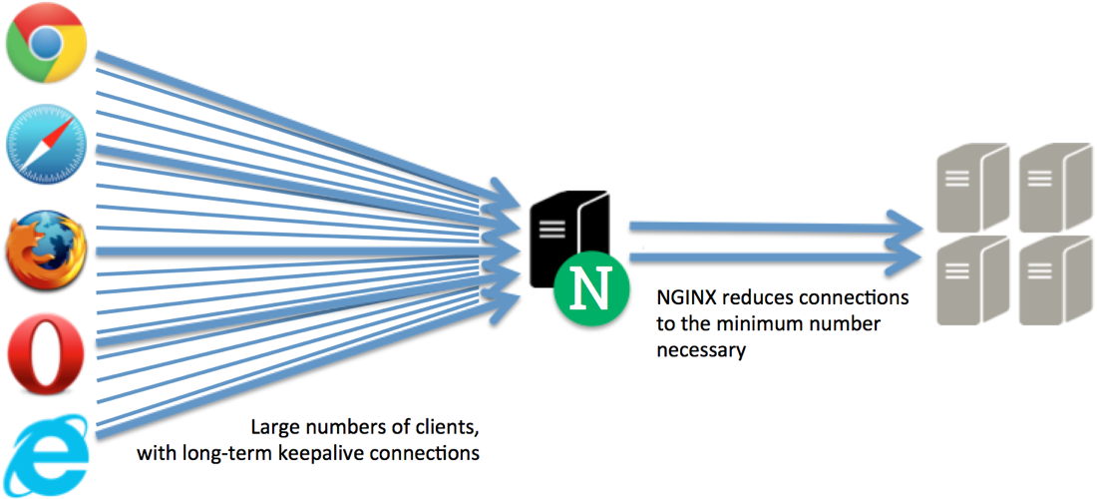
https://www.nginx.com/blog/load-balancing-with-nginx-plus-part2

Slide 49
Upstream directive
worker_processes 4;
events { worker_connections 1024; }
http {
sendfile on;
upstream app_servers {
server greetingsweb:5000;
}
server {
listen 80;
location / {
proxy_pass http://app_servers;
proxy_redirect off;
proxy_set_header Host $host;
proxy_set_header X-Real-IP $remote_addr;
proxy_set_header X-Forwarded-For $proxy_add_x_forwarded_for;
proxy_set_header X-Forwarded-Host $server_name;
}
}
}

Slide 50
Demo
Notes:
1: Switch to nginx_load_balancer
Note the change the nginx conf file, in upstream we have changed from
server greetingsweb:5000 tp server web:5000
From hostname to container name
Run: docker-compose up —build —scale web=4
Show that the reverse proxy will now route between the apps in a swarm - we have load balancing
2: Show how the networking in docker uses an internal name server
Shell into the proxy: docker exec -it XXXXXXX bin/bash
apt-get update
apt-get install dnsutils
nslookup app
Now do mount
Navigate to the shared resolve.conf
Show the address of the name server
3: Show that as you scale down though, nginx is responds to requests only from the remaining containers
From a second terminal window run:
docker-compose up -d —scale web=2
Note in the logs in the first terminal that we can see containers shutting down
Note that now we only round-robin between the containers that are ‘up'
4: You used to have to use resolver, with the address of the name server to route between the healthy instances that are visible by the name server, but this has now been fixed. However, it’s useful to show the nginx syntax for this, because it shows you how to use a DNS server to load balance (you just use the IP address of the external server, not the host name server).
Switch to nginx_load_balancer_with_resolver
Run docker-compose up —build —scale web=4
Show proxying requests
From a second terminal window run:
docker-compose up -d —scale web=2
Note in the logs in the first terminal that we can see containers shutting down
Note that now we only round-robin between the containers that are ‘up'

Slide 51
SSL

Slide 52
5m

Slide 53
Demo
Notes:
1: Switch to nginx_load_balancer
Note the change the nginx conf file, in upstream we have changed from
server greetingsweb:5000 tp server web:5000
From hostname to container name
Run: docker-compose up —build —scale web=4
Show that the reverse proxy will now route between the apps in a swarm - we have load balancing
2: Show how the networking in docker uses an internal name server
Shell into the proxy: docker exec -it XXXXXXX bin/bash
apt-get update
apt-get install dnsutils
nslookup app
Now do mount
Navigate to the shared resolve.conf
Show the address of the name server
3: Show that as you scale down though, nginx is responds to requests only from the remaining containers
From a second terminal window run:
docker-compose up -d —scale web=2
Note in the logs in the first terminal that we can see containers shutting down
Note that now we only round-robin between the containers that are ‘up'
4: You used to have to use resolver, with the address of the name server to route between the healthy instances that are visible by the name server, but this has now been fixed. However, it’s useful to show the nginx syntax for this, because it shows you how to use a DNS server to load balance (you just use the IP address of the external server, not the host name server).
Switch to nginx_load_balancer_with_resolver
Run docker-compose up —build —scale web=4
Show proxying requests
From a second terminal window run:
docker-compose up -d —scale web=2
Note in the logs in the first terminal that we can see containers shutting down
Note that now we only round-robin between the containers that are ‘up'

Slide 54
Q&A

Slide 55
Building from Source
Health Checks
Includes
Redis and Memcached
Monitoring
Notes:
What we didn’t have time to talk about

Slide 56


